Slide 1
Technology Integration Research Project Karlene Roberts ENC 710: Learning in an Era of Technology Dr. Dean Cantu June 17, 2020

Slide 2
CITY UNIVERSITY OF NEW YORK
11 senior colleges, 7 community colleges, 7 graduate honors and professional schools.
275,000 degree seeking students, 250,000 continuing education and certificate students.
Institution that offers economic mobility to low income individuals.

Slide 3
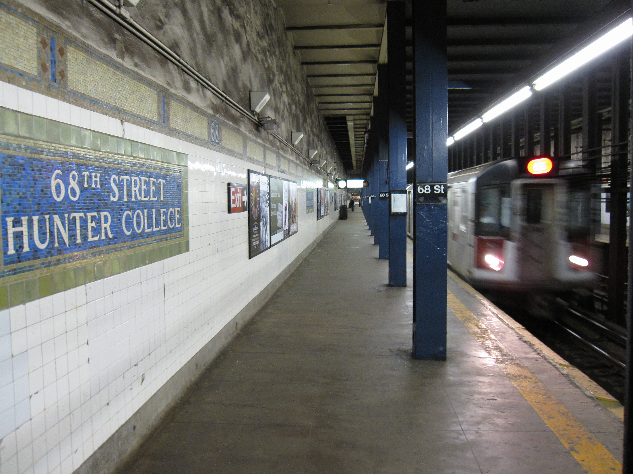
CUNY Hunter College
Source: https://images.app.goo.gl/i2xvkGAH1fboLKZ79
Source: https://images.app.goo.gl/N8KNF1RSSibw92xf6

Slide 4
Student Centered Approach
“By placing students at the center, we can frame our understanding and design of programs, course offerings, and institutions based on their attributes and needs. In this way, our institutional policies and practices can better help students overcome barriers to successful completion. In addition, we can expand our ability to provide higher education opportunities for a greater number of students, with a broader range of needs, at a lower cost” (Reimagining the Role of Technology in Higher Education, 2017).

Slide 5
Philosophy of Higher Education
In addition to being an avenue for financial and intellectual mobility, I also see higher education as an opportunity for personal and professional growth. As a higher education administrator, I aim to serve students with a supportive and holistic approach while challenging them to expand their horizons.

Slide 6
Theoretical Construct
“Constructivism says that people learn by making sense out of the world; they make meaning out of what they encounter” (Reiser & Dempsey, 2018. p. 61)

Slide 7
Incorporating Technology
“Allow students to adjust the timing and format of education to fit other priorities in their lives” (Reimagining the Role of Technology in Higher Education, 2017).
Serious eLearning : A more performance focused, engagement driven, student centered method which uses authentic context with real world consequences making it more relevant for the 21st century than typical e-learning. https://elearningmanifesto.org

Slide 8
Professional Development
Source: https://acert.hunter.cuny.edu

Slide 9
Accessibility
“When considering reaching as many learners as possible, the instructional designer must be aware of the presence of different abilities and cultures and technologies used by individuals to overcome learning barriers” (Reiser & Dempsey, 2018, p. 309)

Slide 10
Social Justice & Equity
“Provide students with affordable access to the high-quality resources they need to be successful and to empower them to become curators of their own learning” (Reimagining the Role of Technology in Higher Education, 2017).

Slide 11
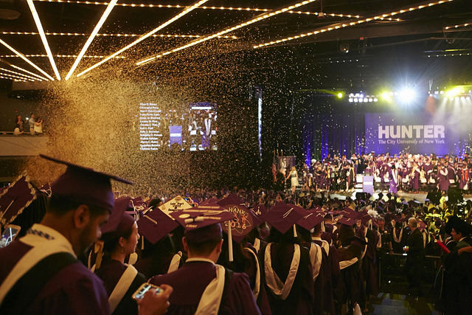
Learning that supports students
Create a network of learning that supports students as creators and entrepreneurs, and agents of their own learning” (Reimagining the Role of Technology in Higher Education, 2017).

Slide 12
References
References
Hunter College (n.d.). Academic Center for Excellence in Research
and Teaching. https://acert.hunter.cuny.edu
Reiser, R. A., Dempsey, J. V. (2018) Trends and issues in instructional
design and technology. Pearson.
The Instigators (n. d.). Serious eLearning manifesto.
https://elearningmanifesto.org
The City University of New York. (n.d.). Mission. The City University of New York.
Retrieved June 14, 2020, from https://www.cuny.edu/about/mission/
U.S. Department of Education, Office of Educational Technology
(2017, January). Reimagining the role of technology in higher education: A
supplement to the National Educational Technology Plan.
https://tech.ed.gov/files/2017/01/Higher-Ed-NETP.pdf

